Slide 1
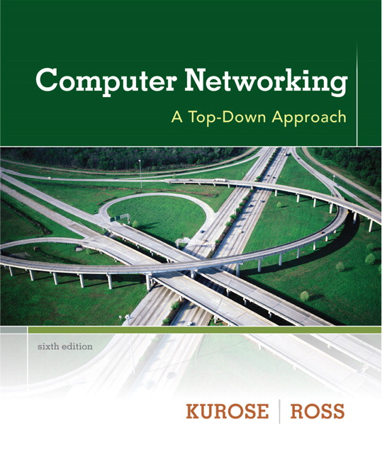
Chapter 4 Network Layer
Computer Networking: A Top Down Approach 6th edition Jim Kurose, Keith Ross Addison-Wesley March 2012
Course Name:
Computer Networks
Lecture by:
Dr. Moeenuddin Tariq

Slide 2
Chapter 4: outline
4.1 introduction
4.2 virtual circuit and datagram networks
4.3 what’s inside a router
4.4 IP: Internet Protocol
datagram format
IPv4 addressing
ICMP
IPv6
4.5 routing algorithms
link state
distance vector
hierarchical routing
4.6 routing in the Internet
RIP
OSPF
BGP
4.7 broadcast and multicast routing

Slide 3
Router architecture overview
two key router functions:
run routing algorithms/protocol (RIP, OSPF, BGP)
forwarding datagrams from incoming to outgoing link
forwarding tables computed,
pushed to input ports
routing
processor
routing, management
control plane (software)
forwarding data plane (hardware)
high-seed
switching
fabric
router input ports
router output ports

Slide 4
Input port functions
lookup,
forwarding
queueing
line
termination
link
layer
protocol
(receive)
switch
fabric
physical layer:
bit-level reception
data link layer:
e.g., Ethernet
see chapter 5
decentralized switching:
given datagram dest., lookup output port using forwarding table in input port memory (“match plus action”)
goal: complete input port processing at ‘line speed’
queuing: if datagrams arrive faster than forwarding rate into switch fabric

Slide 5
Switching fabrics
transfer packet from input buffer to appropriate output buffer
switching rate: rate at which packets can be transfer from inputs to outputs
often measured as multiple of input/output line rate
N inputs: switching rate N times line rate desirable
three types of switching fabrics
memory
memory
bus
crossbar

Slide 6
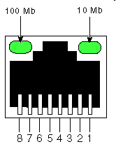
Switching via memory
first generation routers:
traditional computers with switching under direct control of CPU
packet copied to system’s memory
speed limited by memory bandwidth (2 bus crossings per datagram)
input
port
(e.g.,
Ethernet)
output
port
(e.g.,
Ethernet)
memory
system bus

Slide 7
Switching via a bus
datagram from input port memory
to output port memory via a shared bus
bus contention: switching speed limited by bus bandwidth
32 Gbps bus, Cisco 5600: sufficient speed for access and enterprise routers
bus

Slide 8
Switching via interconnection network
overcome bus bandwidth limitations
banyan networks, crossbar, other interconnection nets initially developed to connect processors in multiprocessor
advanced design: fragmenting datagram into fixed length cells, switch cells through the fabric.
Cisco 12000: switches 60 Gbps through the interconnection network
crossbar

Slide 9
Output ports
This slide in HUGELY important!
datagram
buffer
queueing
switch
fabric
link
layer
protocol
(send)
line
termination
buffering required when datagrams arrive from fabric faster than the transmission rate
scheduling discipline chooses among queued datagrams for transmission
Datagram (packets) can be lost due to congestion, lack of buffers
Priority scheduling – who gets best performance, network neutrality

Slide 10
Output port queueing
switch
fabric
switch
fabric
at t, packets more
from input to output
one packet time later
buffering when arrival rate via switch exceeds output line speed
queueing (delay) and loss due to output port buffer overflow!

Slide 11
How much buffering?
RFC 3439 rule of thumb: average buffering equal to “typical” RTT (say 250 msec) times link capacity C
e.g., C = 10 Gpbs link: 2.5 Gbit buffer
recent recommendation: with N flows, buffering equal to
.
RTT C
N

Slide 12
Input port queuing
fabric slower than input ports combined -> queueing may occur at input queues
queueing delay and loss due to input buffer overflow!
Head-of-the-Line (HOL) blocking: queued datagram at front of queue prevents others in queue from moving forward
switch
fabric
switch
fabric
output port contention:
only one red datagram can be transferred. lower red packet is blocked
one packet time later: green packet experiences HOL blocking

